Slide 1

E-TICKETING SYSTEM
18CSC209J - Database Management System and Cloud Integration Services
Mini Project Report
Submitted by
Yatindra Pabbati [Reg. No.: RA2111028010016] B.Tech. CSE –CLOUD COMPUTING
Ayush Raj [Reg. No.: RA2111028010007] B.Tech. CSE –CLOUD COMPUTING
Zaid Hamdaan [Reg. No.: RA2111028010063] B.Tech. CSE –CLOUD COMPUTING
DEPARTMENT OF NETWORKING AND COMMUNICATION SCHOOL OF COMPUTING
COLLEGE OF ENGINEERING AND TECHNOLOGY SRM INSTITUTE OF SCIENCE AND TECHNOLOGY
(Under Section 3 of UGC Act, 1956)

Slide 2
S.R.M. NAGAR, KATTANKULATHUR – 603 203 KANCHEEPURAM DISTRICT
MAY 2023

Slide 3
BONAFIDE
This is to certify that 18CSC209J - DATABASE MANAGEMENT SYSTEM AND CLOUD INTEGRATION
SERVICES LABORATORY Mini Project report titled “
”is the bonafide work of
Yatindra Pabbati [Reg. No.: RA2111028010016]
, Ayush Raj [Reg. No.: RA2111028010007], Zaid Hamdaan [Reg.
No.: RA2111028010063]
who undertook the task of completing the project within the
allotted time.
SIGNATURE
SIGNATURE
Dr.T Preethiya
Assistant Professor
Dr.AnnapuraniPanaiyappan K Professor and Head
Department of Networking And Communication
SRM Institute of Science
and Technology
Department of Networking and Communication
SRM Institute of Science
and Technology

Slide 4
TABLE OF CONTENTS
Chapter No. | Title | Page No.
1. | Abstract | 4
2. | Introduction | 5
3. | Problem Statement | 6
4. | Module Description | 7
5. | Use case diagram | 8
6. | ER diagram | 9
7. | Database Creation using DDL and DML | 10
8. | Normalization of Database | 12
10. | Conclusion | 14
11 | Appendix I - Screenshot | 15
12 | Appemdix II - Github Profile | 16
13 | Appendix III - AWS Course Completion certificate | 17

Slide 5
ABSTARCT
The e-ticketing system project aims to provide a convenient and efficient way for users to purchase and manage tickets for events or transportation. This project will be implemented using MySQL to store and manage the ticketing data. The system will include a user interface for customers to browse and select events or transportation options, make payments, and receive e-tickets. Additionally, the system will have an administrative interface for event organizers or transportation companies to manage and update their offerings, as well as view sales reports andcustomer data. The SQL will provide efficient data storage, retrieval, and management, while ensuring data security and integrity.
The project will be designed and implemented using best practices for software development and database design. Ultimately, the e-ticketing
system will provide a seamless experience for users, while improving the efficiency and effectiveness of event and transportation management.

Slide 6
INTRODUCTION
An E-ticketing system is a web-based application that allows customers to purchase and book tickets for events, movies, flights, trains, and other activities electronically. The system eliminates the need for physical tickets and enables customers to purchase tickets from anywhere at any time.
Developing an E-ticketing system requires a robust and reliable database management system that can efficiently handle large amounts of data and transactions. The DBMS will be responsible for storing customer information, ticket details, transaction history, and other critical data related to the ticketing process.
This project aims to design and develop an E-ticketing system using a DBMS that can effectively manage and organize the data required for ticket booking and management. The system will provide customers with an easy-to-use interface to browse available tickets, select their preferred seats, make payments, and receive e-tickets. The system will also provide administrators with a dashboard to manage the ticket inventory, view transaction reports, and perform other administrative tasks.
Overall, this project will deliver an efficient and user-friendly E-ticketing system that will simplify the ticketing process and enhance the customer experience.

Slide 7
PROBLEM STATEMENT
An E-Ticketing system is a software application that enables users to purchase and manage tickets for events or transportation services online. This type of system is widely used in various industries, including entertainment, sports, transportation, and tourism.
The primary goal of an e-ticketing system is to provide a seamless and convenient ticket purchasing experience for users while automating the ticketing process for event organizers and service providers. The system typically allows users to browse events, select seats or transportation options, make payments, and receive digital tickets or confirmation emails.

Slide 8
MODULE DESCRIPTION
Overview:
The E-Ticketing System Using Dynamo DB module is designed to provide users with a web-based platform to purchase and manage tickets for events, such as concerts, movies, sporting events, and other entertainment activities, while utilizing the powerful features of Dynamo DB. The module is intended to provide learners with an understanding of how to build a scalable and efficient ticketing system using AWS Dynamo DB, one of the most popular NoSQL databases.
Learning Outcomes:
By the end of this module, learners will be able to:
Understand the principles of Dynamo DB and how it can be used for scalable web applications.
Design and develop an e-ticketing platform using Dynamo DB. Implement Dynamo DB features such as Global Secondary Indexes, Streams, and Dynamo DB Accelerator (DAX).
Implement efficient data access patterns using Dynamo DB.
Design and implement a secure payment system for online transactions.
Assessment Methods:
Assessment for this module will be based on the development of afunctional e-ticketing system using Dynamo DB. Learners will be required to submit a final project report and demonstrate the functionality of their system. Additionally, learners will be assessed based on their understanding of Dynamo DB and their ability to apply appropriate design and development principles. Assessment Methods:
Assessment for this module will be based on the development of a functional e-ticketing system using Dynamo DB. Learners will be required to submit a final project report and demonstrate the functionality of their system. Additionally, learners will be assessed based on their understanding of Dynamo DB and their ability to apply appropriate design and development principles.

Slide 9
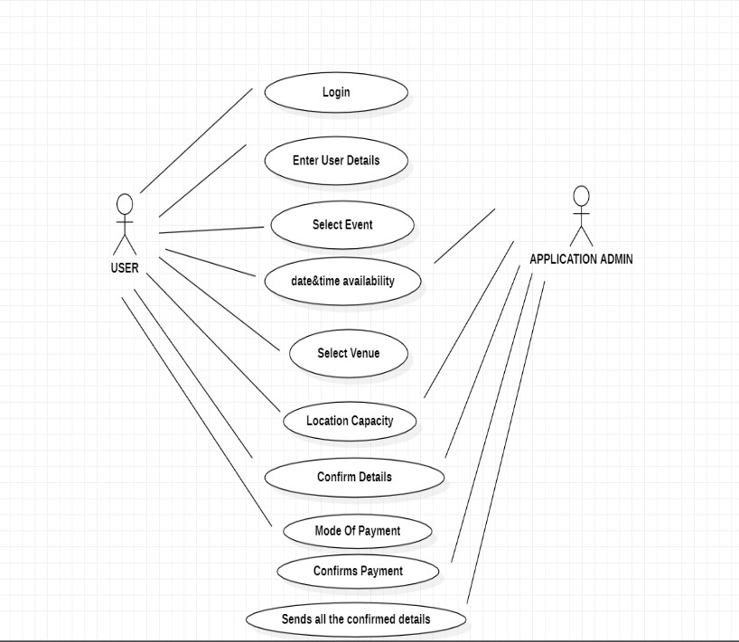
USE CASE DIAGRAM
The use case diagram for an e-ticketing system outlines the actors involved and their interactions with the system. The main actors are the customer, application admin. The use cases include searching for events, selecting and purchasing tickets, managing events and customers, and handling payments. It provides a visual representation of the system's functionalities and helps to identify key requirements for the ticketing process.

Slide 10
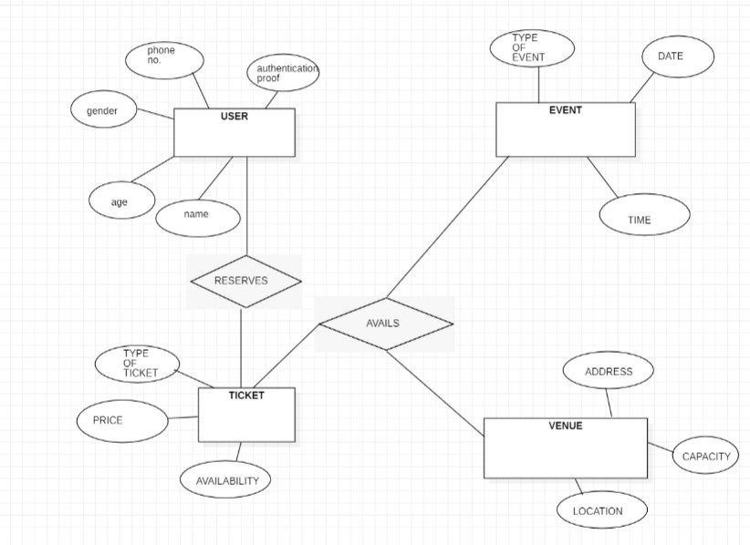
ER DIAGRAM
The ER diagram for an e-ticketing system includes entities such as Event, Venue, Ticket and User shows the relationships between them. Events are held at venues, tickets are sold for events, tickets are purchased by customers, and payments are made for tickets. The ER diagram helps to understand the data entities and their relationships, and provides a foundation for designing the database schema for the system.

Slide 11
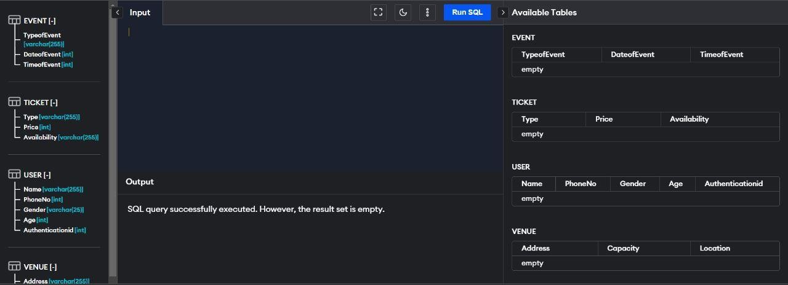
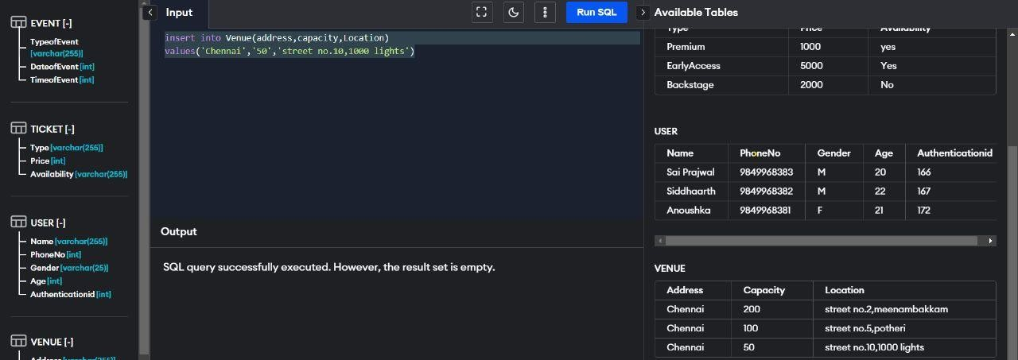
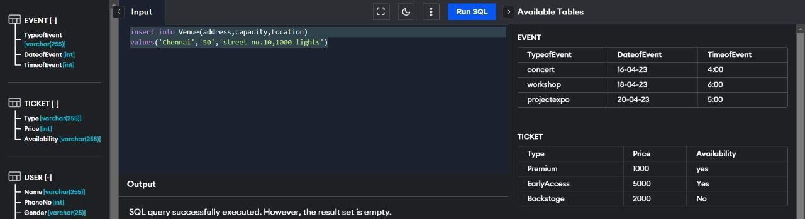
Database Creation using DDL and DML
Creation of a Table:
Values Inserted into the Table:

Slide 12
Code:
create table USER(Name varchar(255), PhoneNo int,
Gender varchar(255), Age int,
Authenticationid int
);
create table TICKET(Type varchar(255), Price int,
Availability varchar(255)
);
create table EVENT(TypeofEvent varchar(255),
DateofEvent varchar(255), TimeofEvent varchar(255),
);
create table TICKET(Type varchar(255), Price int,
Gender varchar(25), Availability varchar(255)
);
insert into Venue(address,capacity,Location) values('Chennai','50','street no.10,1000 lights')
VENUE

Slide 13
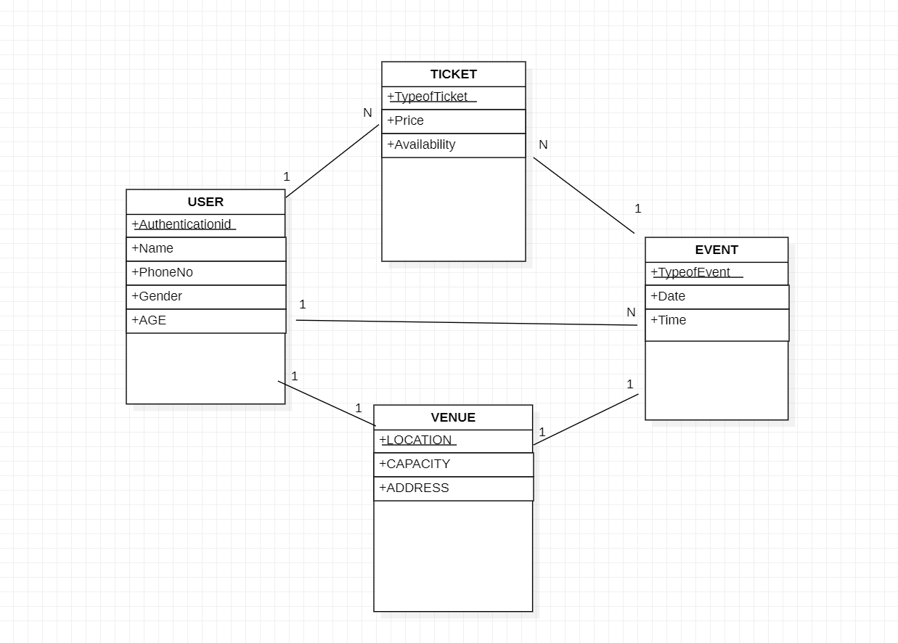
Normalization of Database:

Slide 14
Normalization of a database for an e-ticketing system would typically involve breaking down the data into logical entities and organizing them into tables that follow the rules of normalization. Here are some general steps that might be taken:
Identify the entities: Start by identifying the different types of data that will be stored in the database, such as customers, events, tickets, and transactions.
Break down the entities: For each entity, break down the data into its
component parts. For example, the customer entity might include fields like first name, last name, email address, and phone number.
Define relationships: Determine the relationships between the entities. For example, a customer can buy multiple tickets for different events, so there is a one-to-many relationship between customers and tickets.
Create tables: Create separate tables for each entity, with columns for each component of the data. For example, the customer table might
have columns for first name, last name, email address, and phone number.
Apply normalization rules: Apply the normalization rules to each table to ensure that there is no redundant data and that the data is stored in the most efficient way possible. For example, the customer table might be in first normal form (1NF) by ensuring that each column contains atomic data.
Define keys: Define primary keys for each table to ensure that each row can be uniquely identified. For example, the customer table might use the customer ID as the primary key.
Create relationships: Create foreign keys in tables to establish
relationships between them. For example, the ticket table might have a foreign key that references the customer ID in the customer table.
By following these steps, a database for an e-ticketing system can be normalized to ensure that data is organized efficiently, free of redundancy, and easy to maintain over time.

Slide 15
CONCLUSION
In conclusion, the implementation of an E-ticketing system using a database management system is a highly effective way to streamline the ticketing process and improve the overall user experience. The Database allows for the efficient storage and retrieval of information, providing real-time updates and reducing the risk of errors or data loss.
Additionally, the system can be easily scaled to accommodate increased demand, making it a flexible and future-proof solution. With its numerous benefits and the growing demand for digital ticketing solutions, an E- ticketing system using MySQL essential tool for any organization looking to modernize their ticketing process and provide a better experience for their customers.

Slide 16
Appendix I
Creation of a Table:
Inserting Values into a Table:

Slide 17
Appendix II
Link for GitHub: https://github.com/YatindraPabbati/3rd-sem-mini- project
https://github.com/YatindraPabbati/dbms-exercise- codes
https://github.com/zhamdaan/DBMSCIS
https://github.com/ayushgi
Appendix III

Slide 18
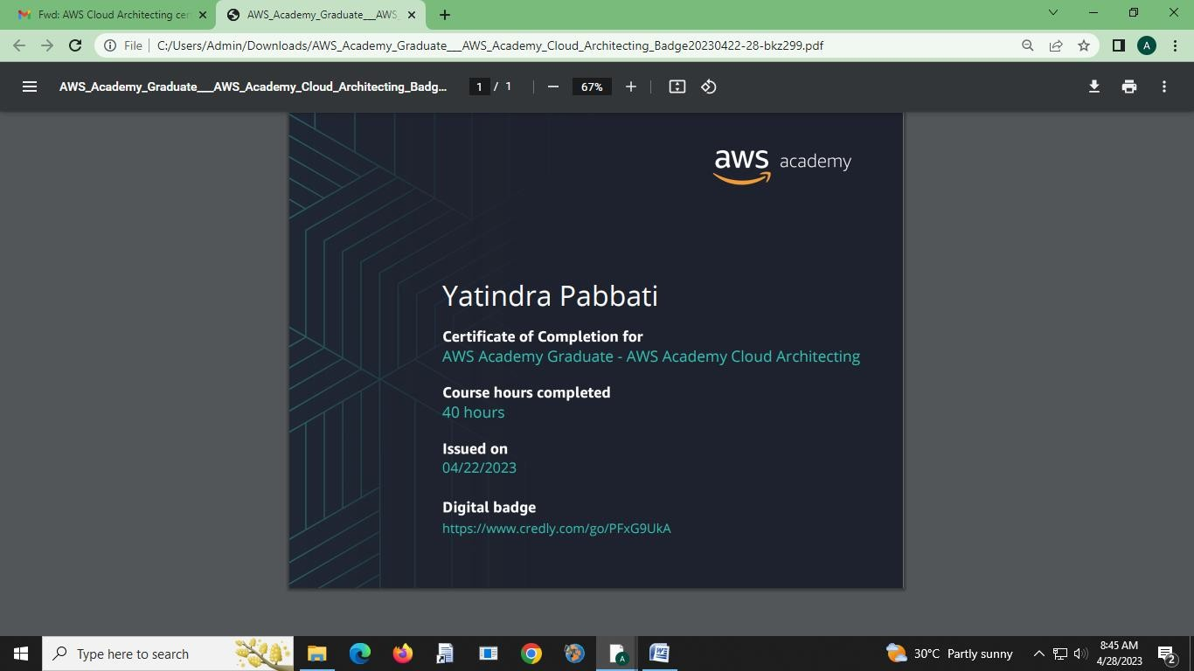
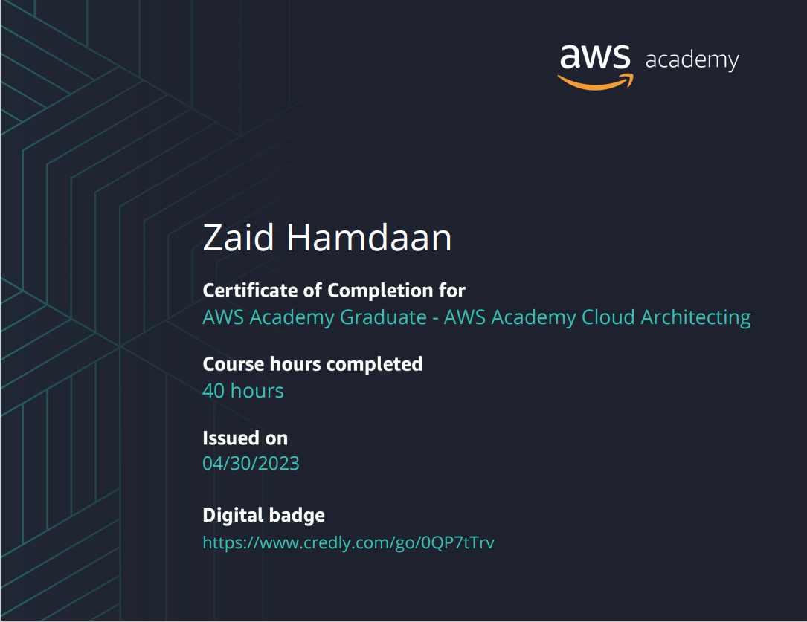

Slide 19
